Slide 1



Data Manipulation
Visual Recipes to be used...
Notes:
Heads up, these are the visual recipes to be used in the next part of the training

Slide 2
Data Manipulation
Visual Recipes to be used...
Visual Recipe that layers datasets with similar schemas onto each other.
Can run in-database
Equivalent to SQL Union or Union All
Ex. Combine two datasets from different time ranges
Notes:
the first one used is the Stack recipe

Slide 3

Stacking Mosquitos dataset
2009
2010
DATE | TRAP ID | SPECIES | NUM_ MOSQUITOS | ... | ... | WNV
1-1-2010 | A | NORMAL | 1 | ... | ... | 0
1-1-2010 | A | EVIL | 1 | ... | ... | 1
1-1-2010 | B | NORMAL | 1 | ... | ... | 0
2-1-2010 | A | EVIL | 1 | ... | ... | 1
2-1-2010 | B | Normal | 1 | ... | ... | 0
DATE | TRAP ID | SPECIES | NUM_ MOSQUITOS | ... | ... | WNV
1-1-2010 | A | NORMAL | 1 | ... | ... | 0
1-1-2010 | A | EVIL | 1 | ... | ... | 1
1-1-2010 | B | NORMAL | 1 | ... | ... | 0
2-1-2010 | A | EVIL | 1 | ... | ... | 1
2-1-2010 | B | Normal | 1 | ... | ... | 0
Notes:
Here explain why we are stacking the datasets and how it will be used to train a model to help predicting the likelihood of westnile virus spreading in certain locations

Slide 4
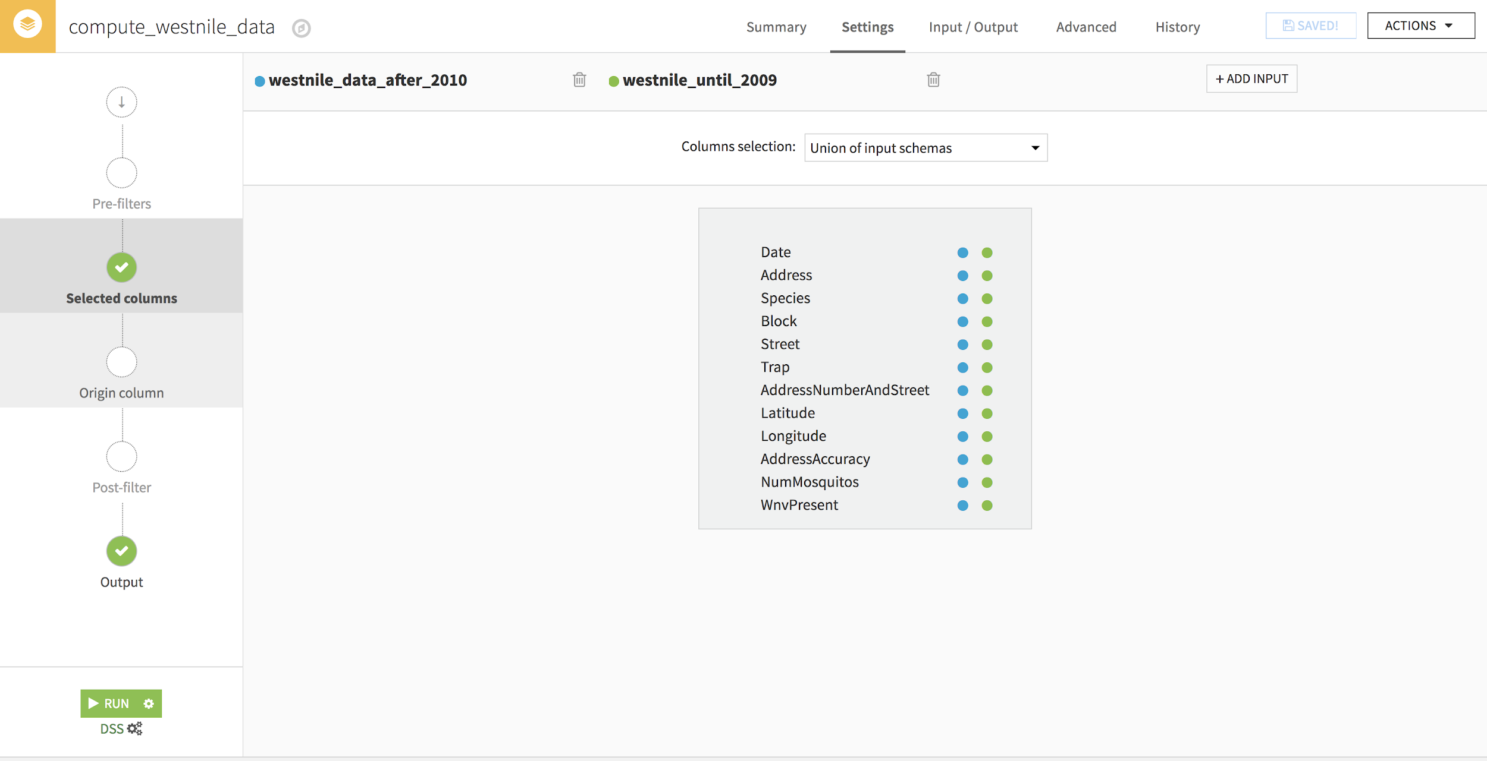
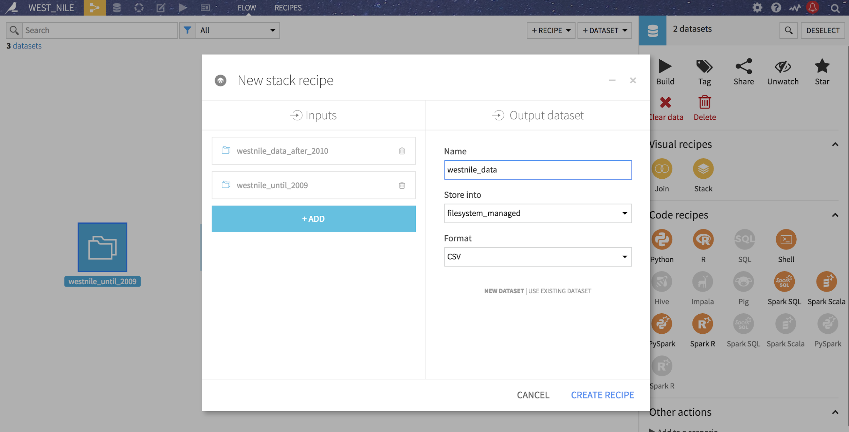
Stack westnile dataset for 2009 and 2010
Click on westnile_until_2009 and westnile_data_after_2010
Choose Stack recipe
Name your output dataset: westnile_data
store into hdfs
Notes:
Explain how the recipe is helping to identify the matching columns in the two datasets

Slide 5
Data Manipulation
Visual Recipes to be used...
This recipe has dual purposes
You can use it to extract a sample from your dataset to work on
and
You can use to extract from your dataset a subset filtered on a specific value
Notes:
the next recipe to use will be the Sample/Filter recipe
explain that it provides either Sampling or Flithering or both

Slide 6
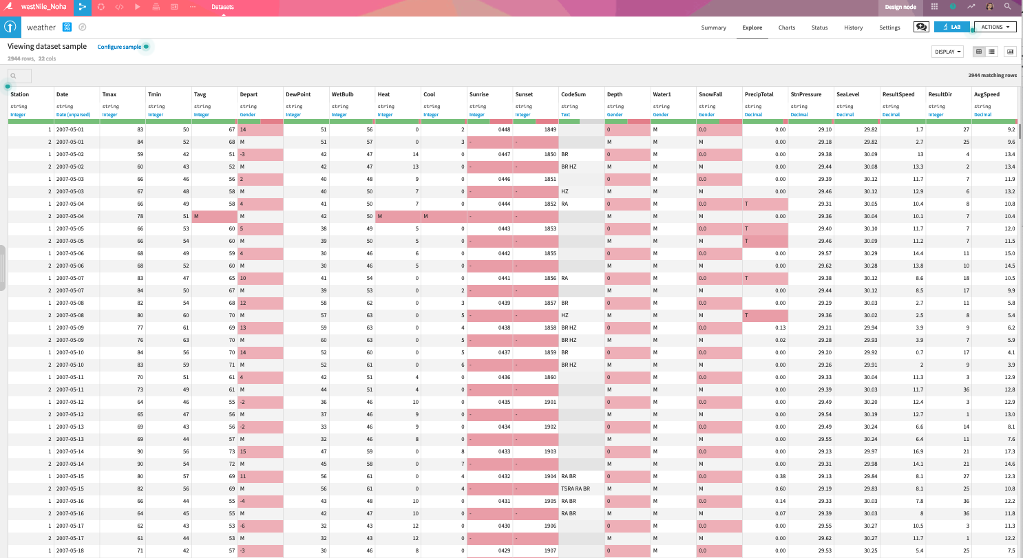
Filtering Weather dataset
Let’s explore the weather data first
Notes:
Here explore with trainees the dataset
cover the concept of RED/GREEN rule
and if you like brainstorm on some suggestions to handle those issues

Slide 7
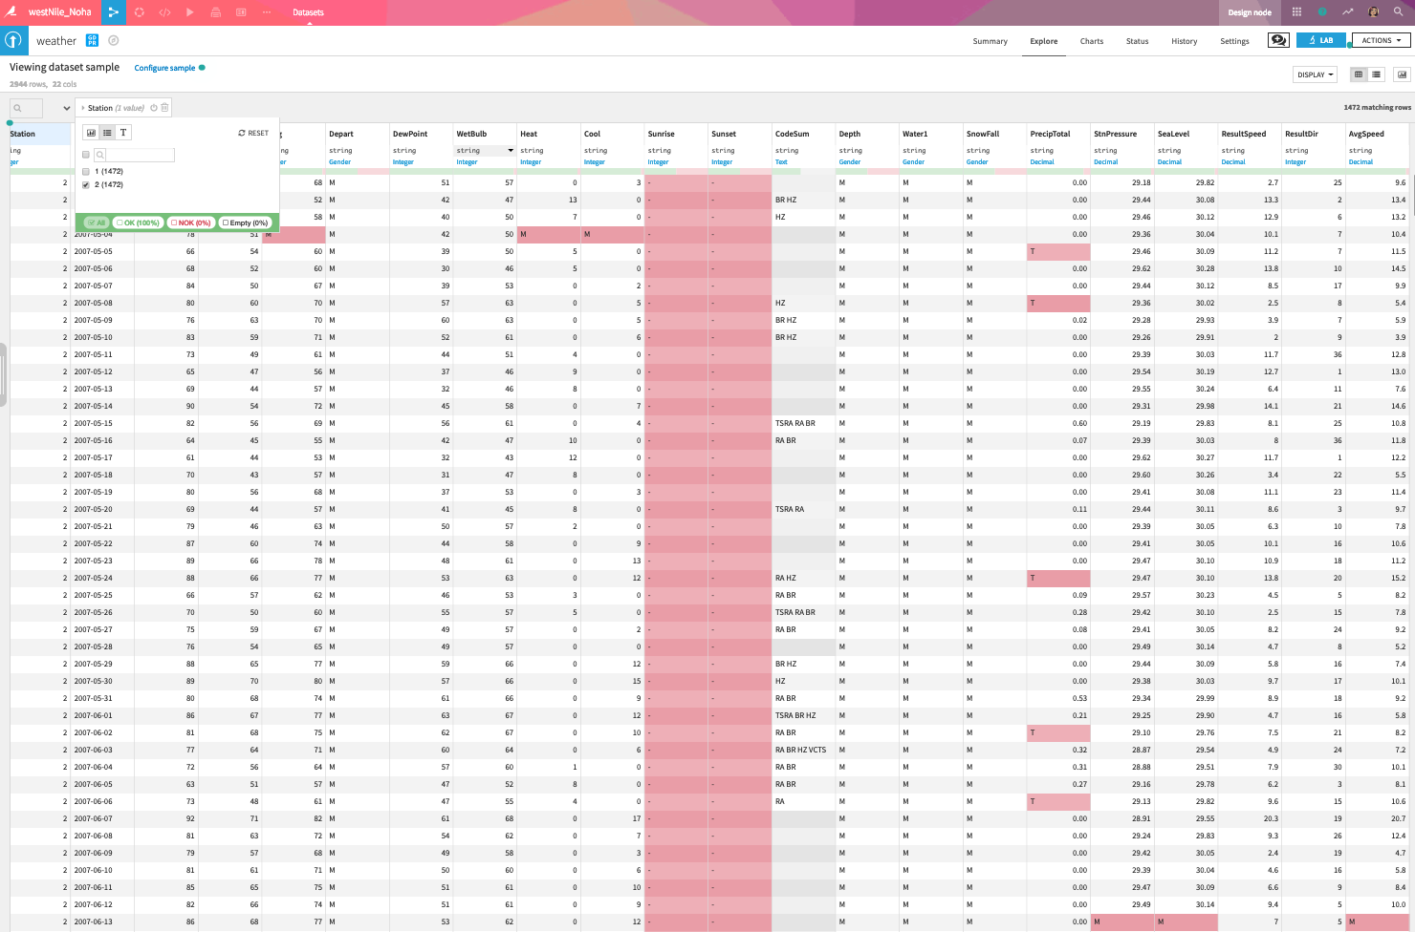
Filtering Weather dataset
1
Do we have enough data for station 2?
2
Notes:
this is the hint given to trainees regarding “Station 2” and the fact that there are no values for sunrise and sunset which will not be helpful for us so, it makes sense to either:
remove these rows
or
filter the dataset on “Station 1”

Slide 8
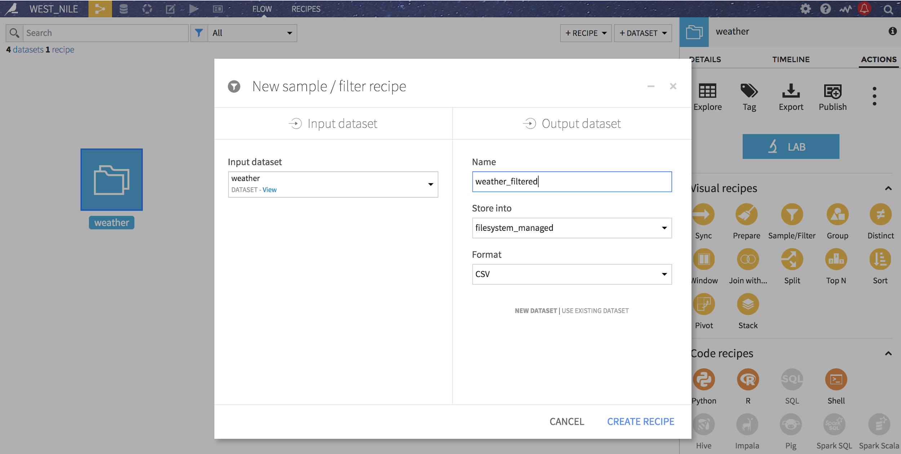
Filtering Weather dataset
Click on Weather dataset and choose Filter/Sample recipe
Notes:
apply the Sample/Filter recipe

Slide 9
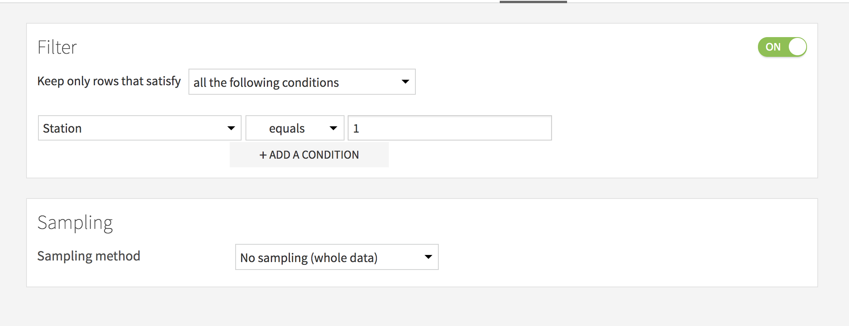
Filtering Weather dataset
Click on Weather dataset and choose Filter/Sample recipe
Notes:
make sure to explain that the recipe does two things
Filter/Sample
as we are using it for filtering, we need to “Activate” the Filter

Slide 10
Data Manipulation
Visual Recipes to be used...
Visual Recipe that can apply transformations from one Dataset and store the output into another, with 90 different processors
Useful for
Cleaning Data
Dropping/Adding Columns
Data Preparation
Data Transformations
And More

Slide 11




Some cleaning and some extractions …
this recipe will help us to …..
Extract the “Year” from the date
to see if there any trend in the virus spreading over the year
Extract the “Day_Number”
to help us understand how far in the year the virus tends to appear
Create a GeoPoint from “Latitude” and “Longitude” for each mosquito trap
and this will allow us to plot our data onto a map
Notes:
Explain the purpose of cleaning some feature and extraction more information
primarily to obtain useful insights related to patterns and locations… etc.

Slide 12
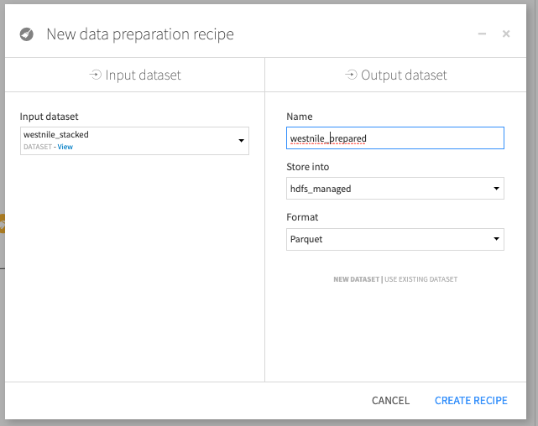
Use preparation recipe on “WESTNILE_DATA”
Save your new dataset in “hdfs_managed:
Extract the “Year” from the date
to see if there any trend in the virus spreading over the year
Notes:
apply the recipe and here again talk about the naming conventions if you feel the need
for enterprise accounts, this can be very important

Slide 13
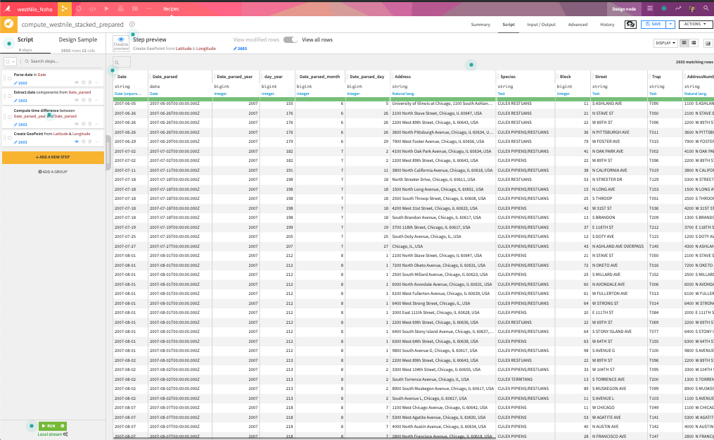
Let’s explore the Preparation Recipe
2
1
3
4
5
Notes:
Explain the prep recipe and take time exploring some processors and different ways to apply them on the dataset
Explain how DSS suggests some relevant steps per columns and provides more through the 90+ processors available for users

Slide 14
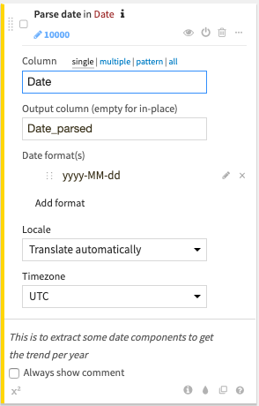
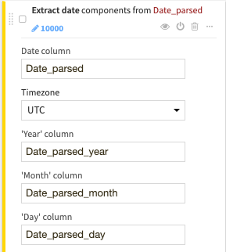
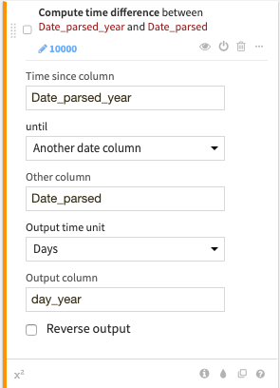
Prep Recipe Steps
3 steps (date)
Notes:
these are the three steps related to Data and extracting more information from data field

Slide 15
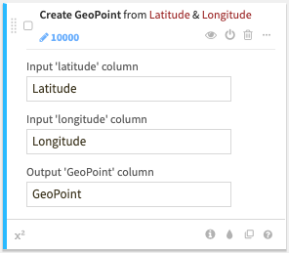
Prep Recipe Steps
1 step (geopoint)
!
Notes:
Here talk about these features
the comment feature
the coloring feature
the copy and the help
and this will be a good opportunity to talk about how DSS is useful in terms of grouping the steps and provide a good reference for other project users
this is a very useful collaboration feature that DSS is providing specially for users who have been using Excel a lot as normally in Excel there are no explanation of any steps or any formulas used

Slide 16


Joining Data
Visual Recipes to be used...
Notes:
Heads up, these are the recipes used in the next part of the training

Slide 17

How was the Mosquitos data collected?
Mosquitoes traps
DATE | TRAP ID | SPECIES | NUM_ MOSQUITOS | ... | ... | WNV
1-1-2010 | A | NORMAL | 1 | ... | ... | 0
1-1-2010 | A | EVIL | 1 | ... | ... | 1
1-1-2010 | B | NORMAL | 1 | ... | ... | 0
2-1-2010 | A | EVIL | 1 | ... | ... | 1
2-1-2010 | B | Normal | 1 | ... | ... | 0
DATE | sunrise | sunset | Heat | Sea_Level | ... | ...
1-1-2010 | 0448 | 1858 | 19 | 29 | ... | ...
1-1-2010 | 0447 | 1857 | 19 | 29 | ... | ...
1-1-2010 | 0446 | 1856 | 19 | 29 | ... | ...
2-1-2010 | 0445 | 1855 | 23 | 30 | ... | ...
Notes:
Explain the need to enrich the mosquitos dataset by joining it with the weather dataset

Slide 18






Shall we go ahead and join the two datasets?
Notes:
This is the good time to cover the smart computation concept in details

Slide 19
Now we can join the data…
Visual Recipes to be used...
Notes:
Explain join recipe
and perhaps here you can cover the concept of relational databases (primary key, foreign key and types of join if you feel your audience need it )

Slide 20
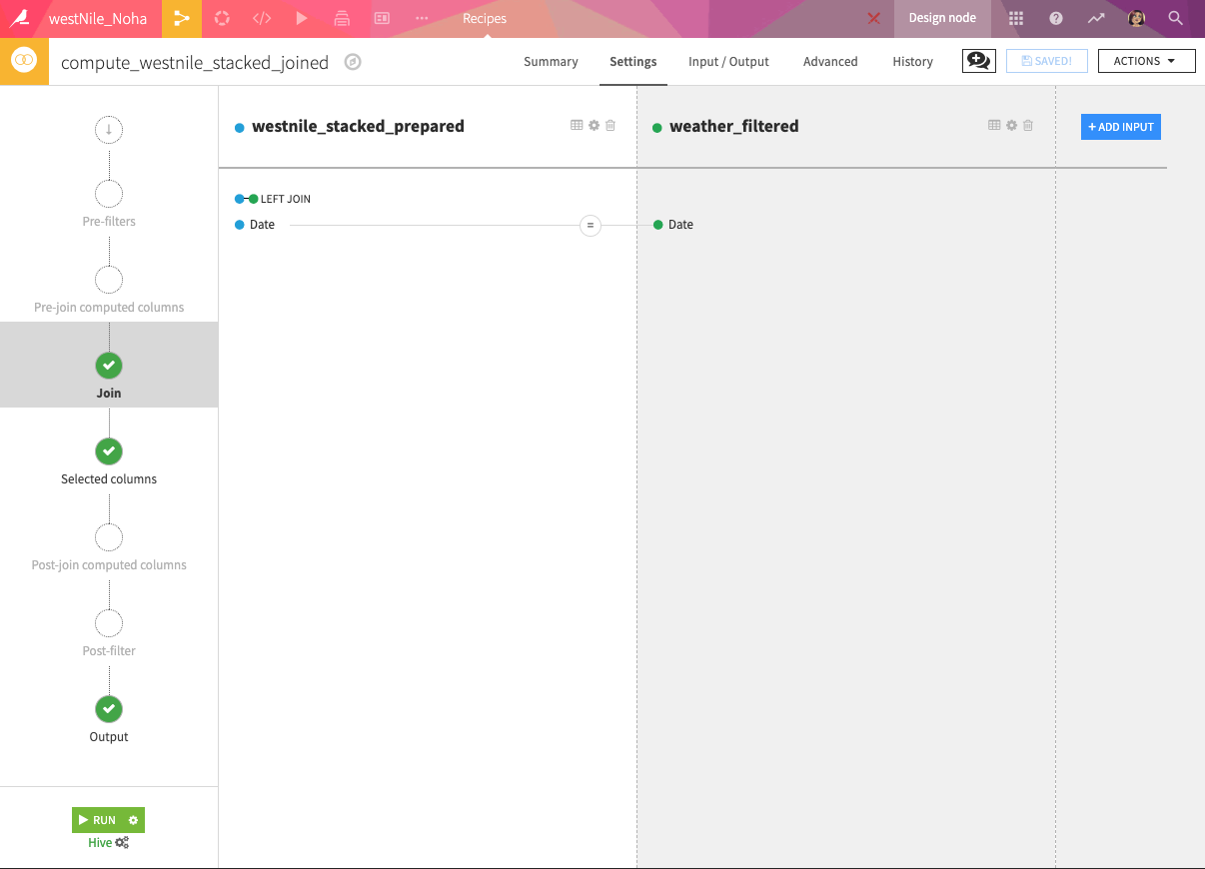
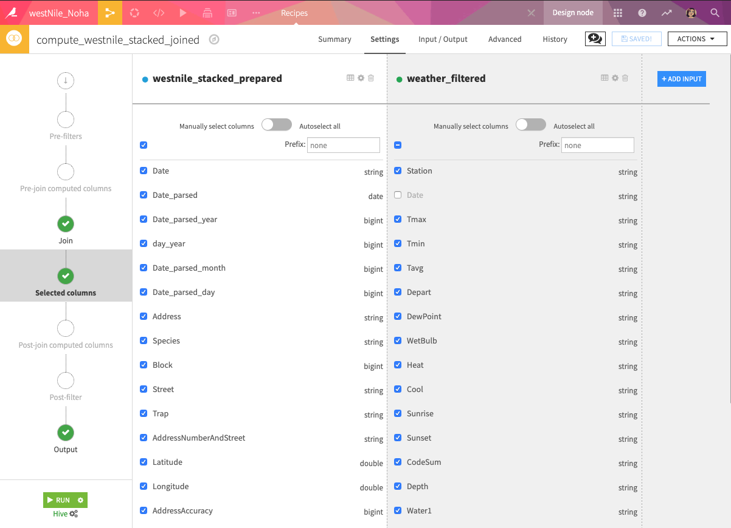
Joining recipe
Join type, Columns, Outcome…
Notes:
here you can cover the Join Types as well as the columns names (adding a prefix ...etc.)

Slide 21
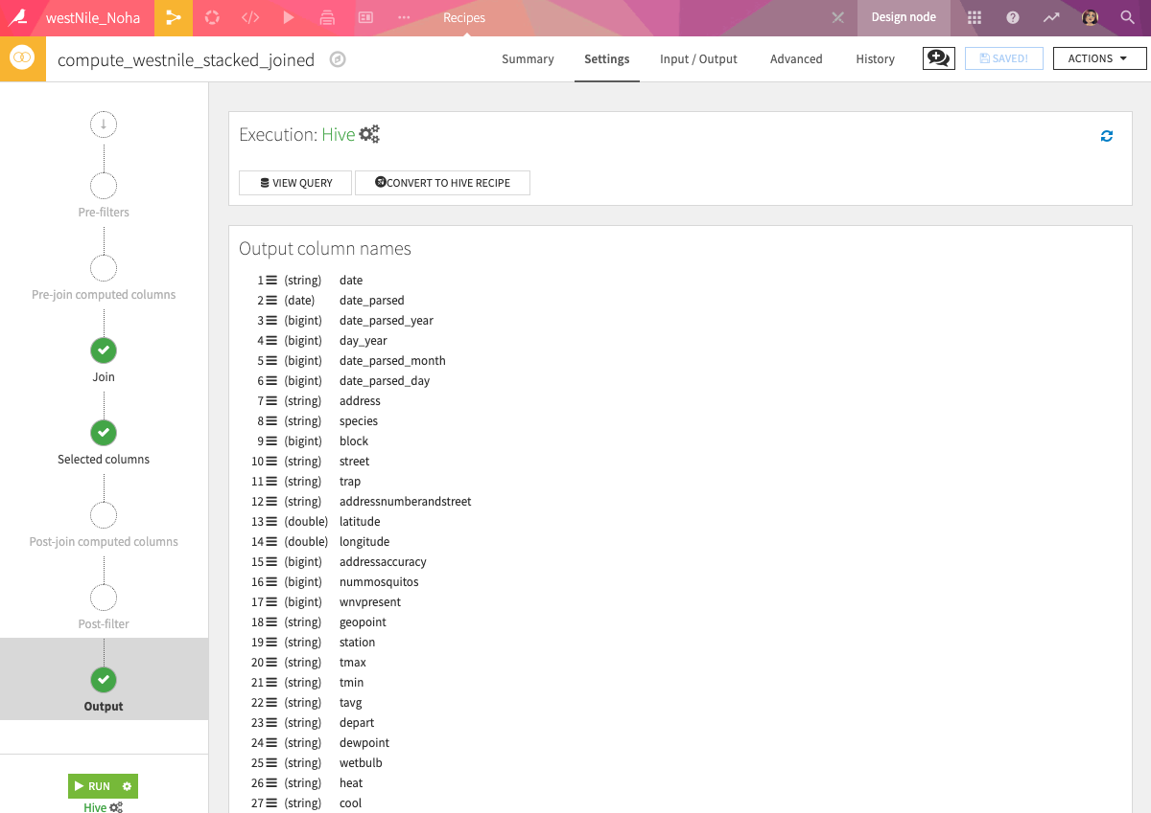
Joining recipe
Join type, Columns, Outcome…
Notes:
Explain how users can access the SQL query from this page
This is a good opportunity to check the code and if the users would like to transform this into a SQL recipe or Hive Recipe
also if the users are beginners, it is a good way to upskill and learn how SQL codes are written for the join step

Slide 22
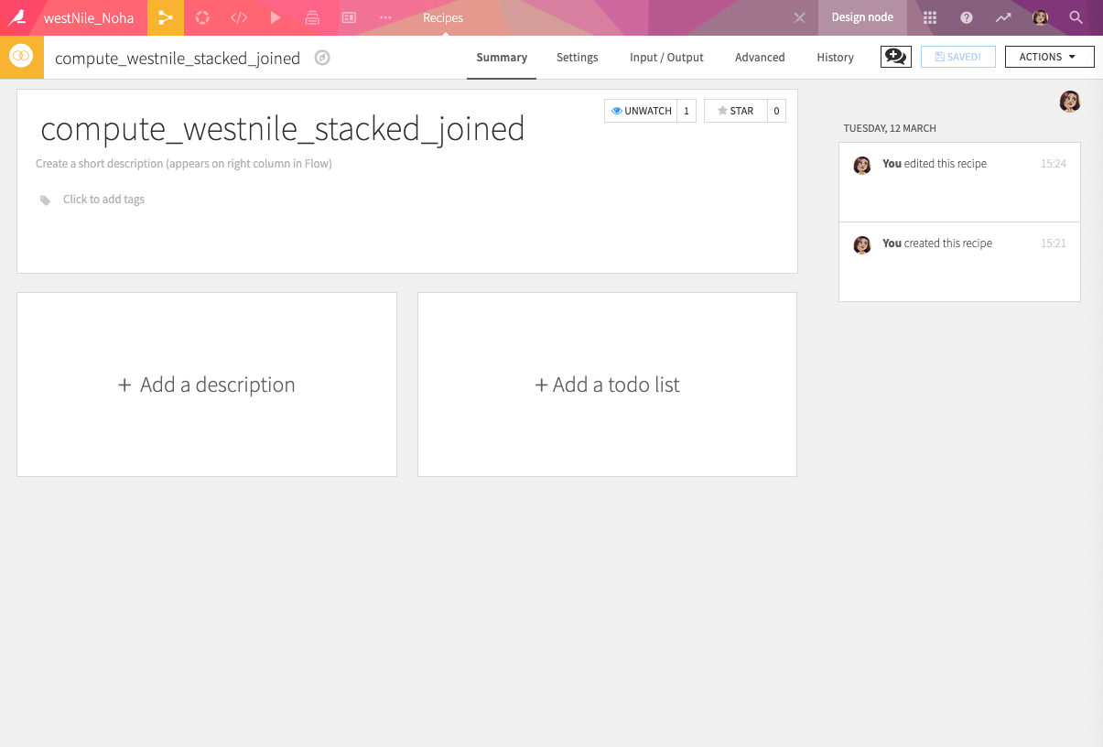
Joining recipe
Join type, Columns, Outcome…
Notes:
This is a good “Pause” and opportunity to talk about documenting steps, collaboration

Slide 23
Aggregating Data
Visual Recipes to be used...

Slide 24
Remember this slide?
Mosquitoes traps
DATE | TRAP ID | SPECIES | NUM_ MOSQUITOS | WNV
1-1-2010 | A | NORMAL | 1 | 0
1-1-2010 | A | EVIL | 1 | 1
1-1-2010 | B | NORMAL | 1 | 0
2-1-2010 | A | EVIL | 1 | 1
2-1-2010 | B | Normal | 1 | 0
Notes:
This is reminder for how the mosquitos data was collected
to explain why we need to do the aggregation
The Chicago Department of Public Health has set up surveillance and control program in order to monitor and control mosquitos.
they placed mosquitoes traps across the city and
every day the mosquitoes caught in the trap are collected and analyzed
so for every trap, there is a Trap ID followed by the identification and sorting of mosquitoes collected from these traps; and the testing of specific species of mosquitoes for WNV existence or not.

Slide 25
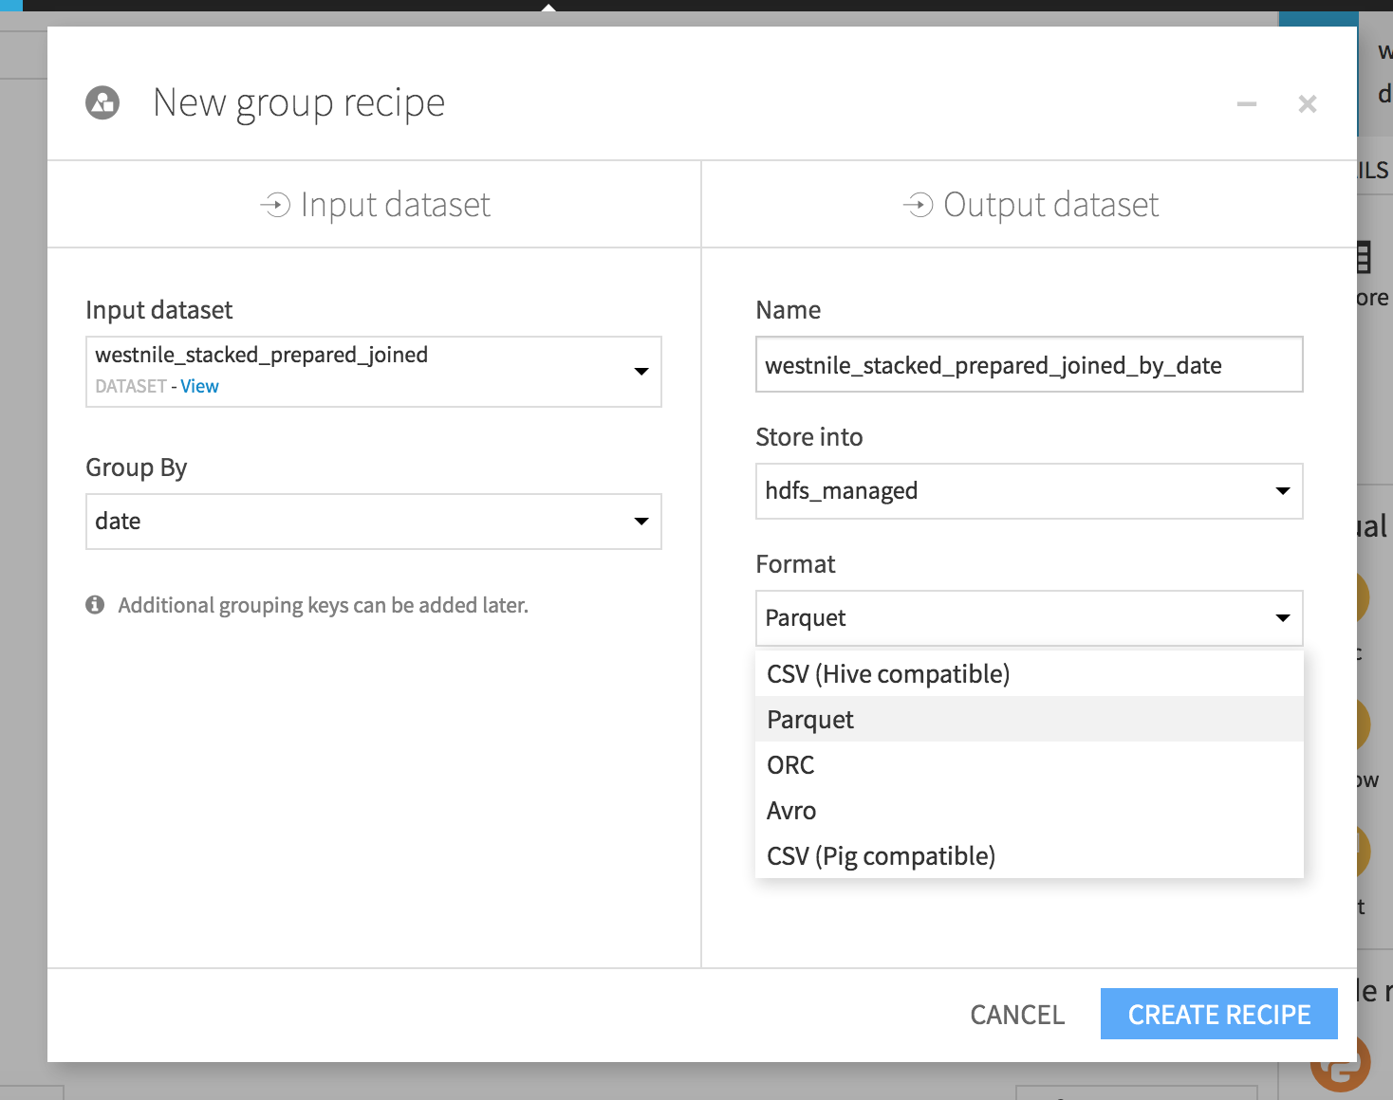
We want one line per DAY per Trap
Notes:
apply the recipe on the dataest

Slide 26
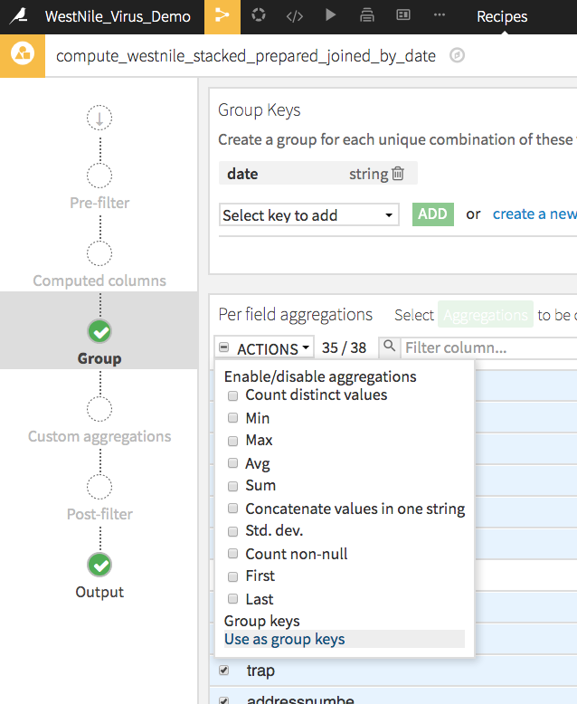
Mass select all the keys from the list in the bottom part of the Group recipe and select the "use as group keys" in the action tab
Notes:
explain how to do mass action and use the features as group keys

Slide 27
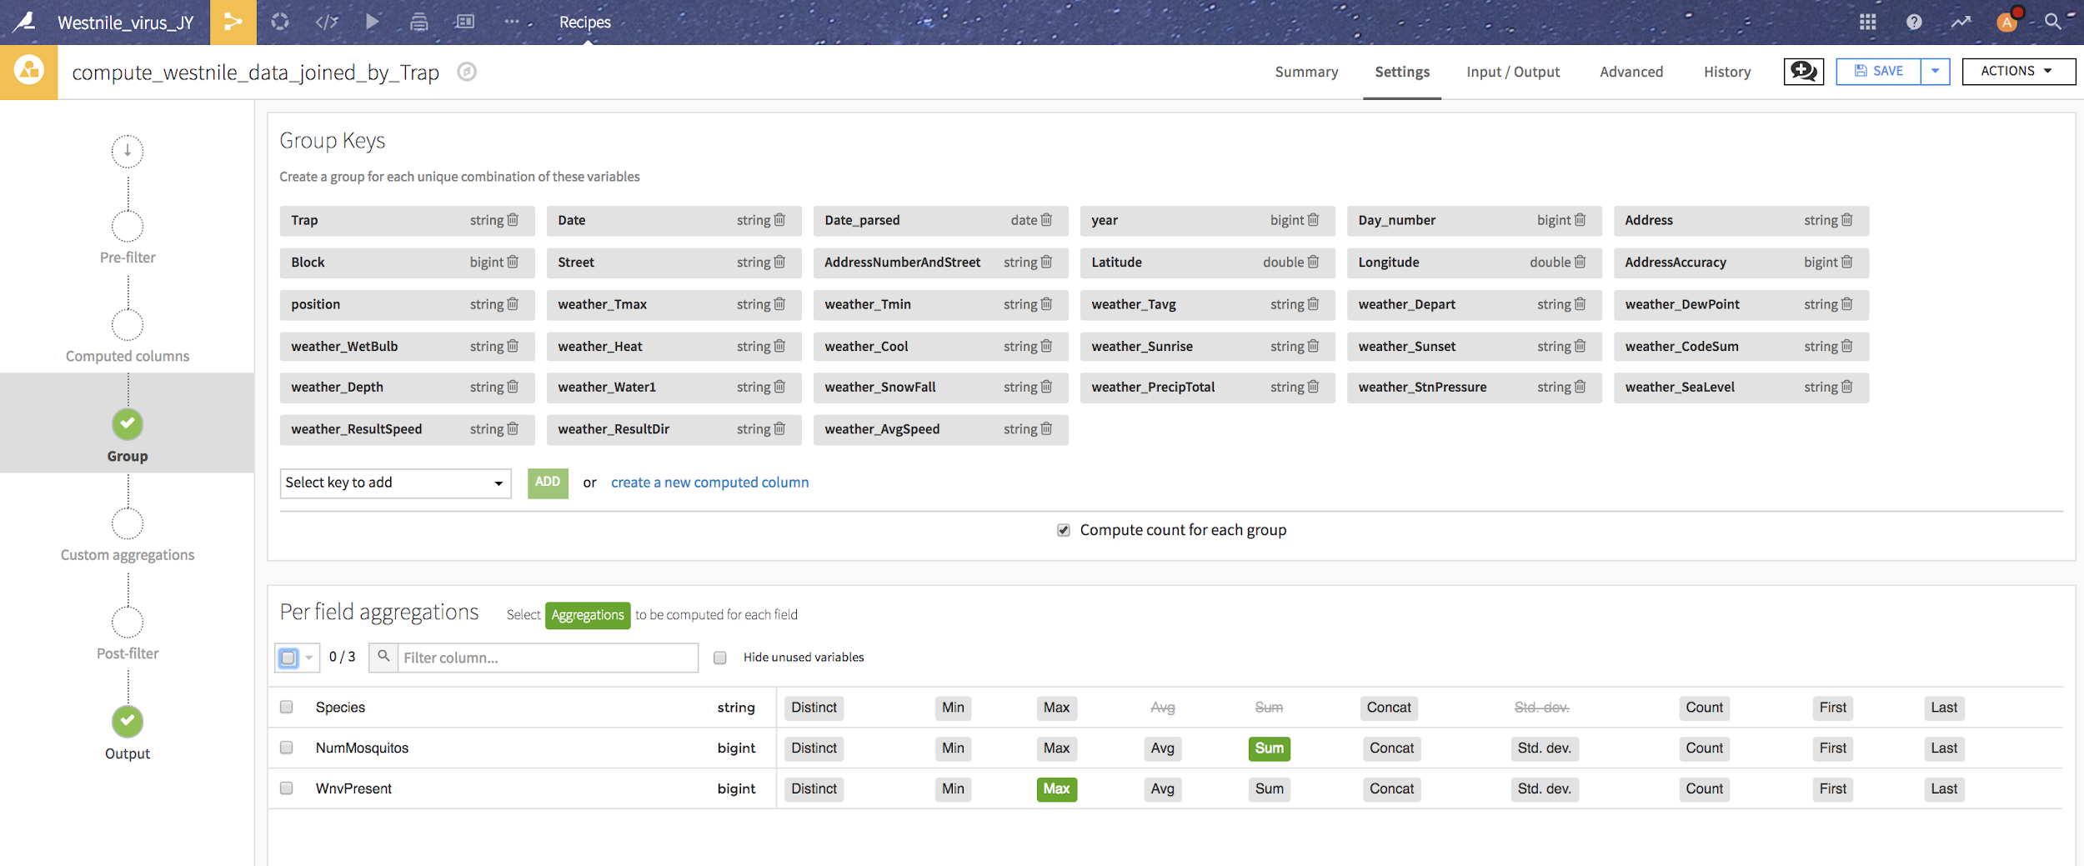
Mass select all the keys from the list in the bottom part of the Group recipe and select the "use as group keys" in the action tab

